Slide 1
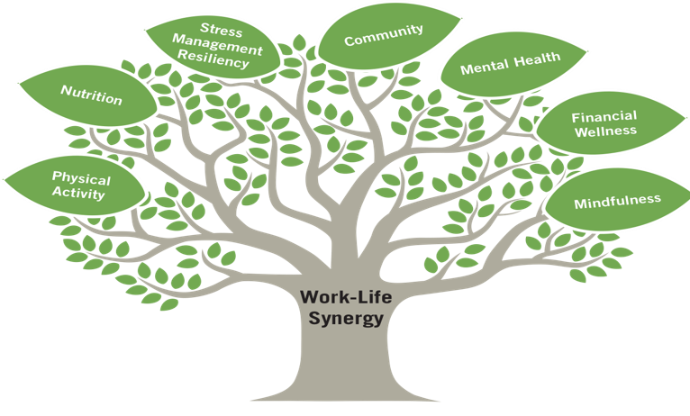

Slide 3
Follow us on Instagram! @GibsonDunnGlobalWellness (don’t worry we won’t follow you back ☺)

